Slide 1
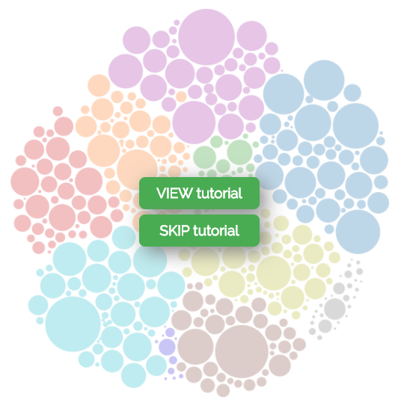
Pave
Is a Canadian
Job Explorer

Slide 2
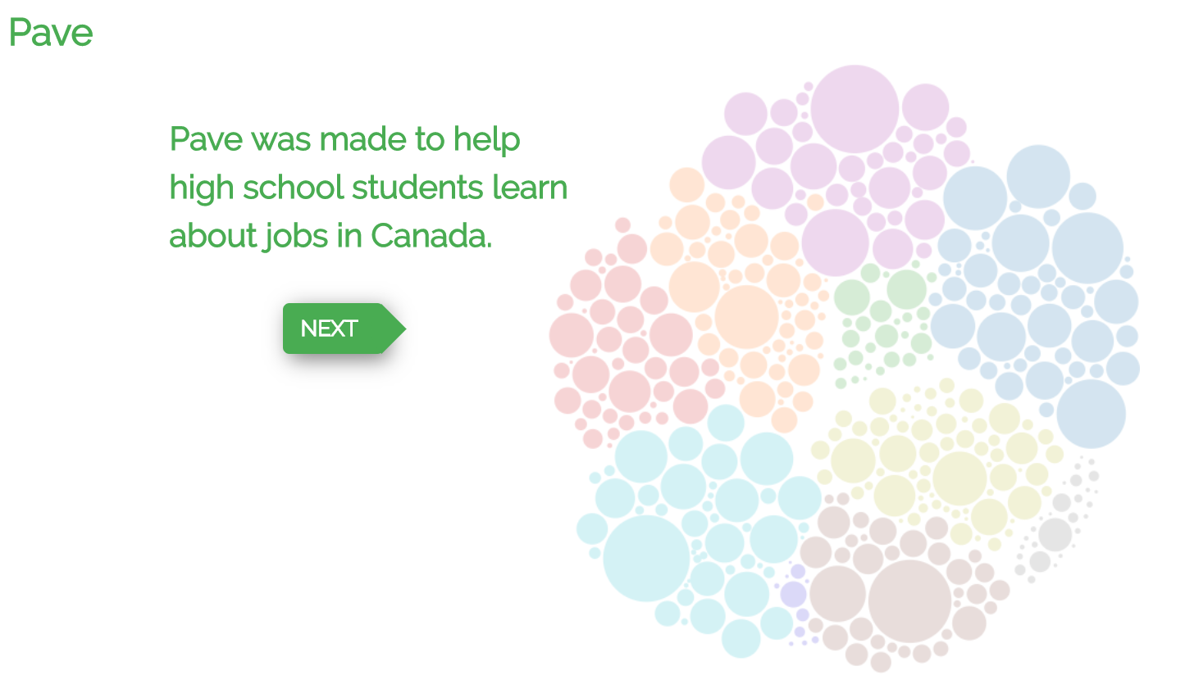



Pave
Tutorial 1 of 5
Pave was made to help simplify career decisions for high school students by showing what’s out there.
Is a Canadian
Job Explorer

Slide 3


You can use Pave to quickly compare many different career paths.
Tutorial 2 of 5

Slide 4
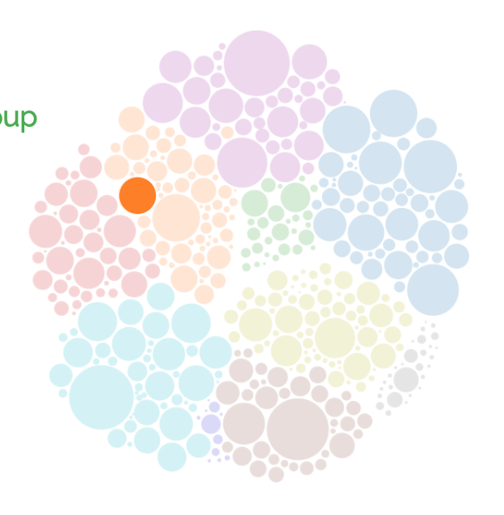

Each circle represents a job group Hover over the circle on the right to see job details
Tutorial 3 of 5

Slide 5
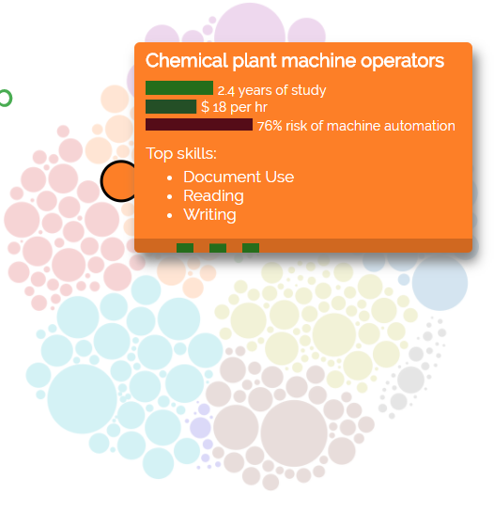

Each circle represents a job group Hover over the circle on the right to see job details Click the circle on the right to see skills used on the job
Tutorial 3 of 5
manufacturer

Slide 6


Each circle represents a job group Hover over the circle on the right to see job details Click the circle on the right to see skills used on the job
Tutorial 3 of 5
manufacturer

Slide 7


Each circle represents a job group Hover over the circle on the right to see job details Click the circle on the right to see skills used on the job
Tutorial 3 of 5
manufacturer
More stuff?!

Slide 8

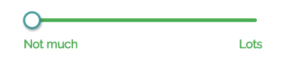
Changing the skill sliders lets you look at jobs that different people would qualify for, based on their different skillsets.
Tutorial 4 of 5

Slide 9
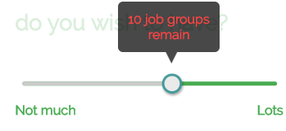

Changing the skill sliders lets you look at jobs that different people would qualify for, based on their different skillsets.
Tutorial 4 of 5

Slide 10

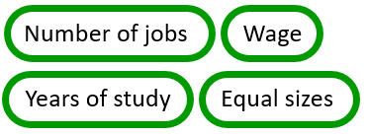
Tutorial 5 of 5
Size by:
options

Slide 11

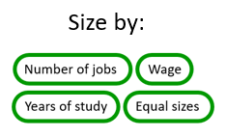

Tutorial 5 of 5
Number of Jobs

